Slide 1

Proactive Road Monitoring
AI-Based Weather-Aware Road Risk Prediction System
Presented by :- Team-13

Slide 2

Problem Identification
Problem Statement Develop an AI system to:
Analyse weather, traffic, and road data
Predict road accident risk levels
Support preventive safety measures.
Real-World Relevance & Impact
Bad weather increases accident risk.
Drivers lack real-time risk awareness.
Authorities need predictive safety tools.
System helps reduce accidents and improve road safety.
.

Slide 3
System Inputs & Outputs
System Inputs
Weather data (temperature, rainfall, visibility, windspeed)
Traffic conditions
Road and location information
Historical accident severity
Expected Output
Road Risk Level Prediction
Low Risk
Medium Risk
High Risk
Alerts for high-risk areas or conditions.

Slide 4
Dataset Overview
Data Collection
Dataset: US Accidents (2016–2023)
Source: Kaggle (Public dataset)
Type: Public dataset
Records available: ~7.7 million
Sample used: 50,000 records
Time Period
Feb 2016 – March 2023

Slide 5
Features and Target Variable
Key Features Used
Weather Features
Temperature, Precipitation
Visibility, Wind Speed
Weather Condition
Traffic & Road Features
Traffic Signal, Junction, Crossing
Road Surface, Sunrise/Sunset
Location Features
City, State, Latitude, Longitude
Target Variable
Accident Severity (1–4) Converted into:
Low Risk
Medium Risk
High Risk

Slide 6
Data Size & Format
Total Records Used: 50,000
Total Columns: 46
Data Format: CSV
Memory Usage: ~62 MB
Dataset contains:
Numerical features
Categorical features
Boolean features

Slide 7
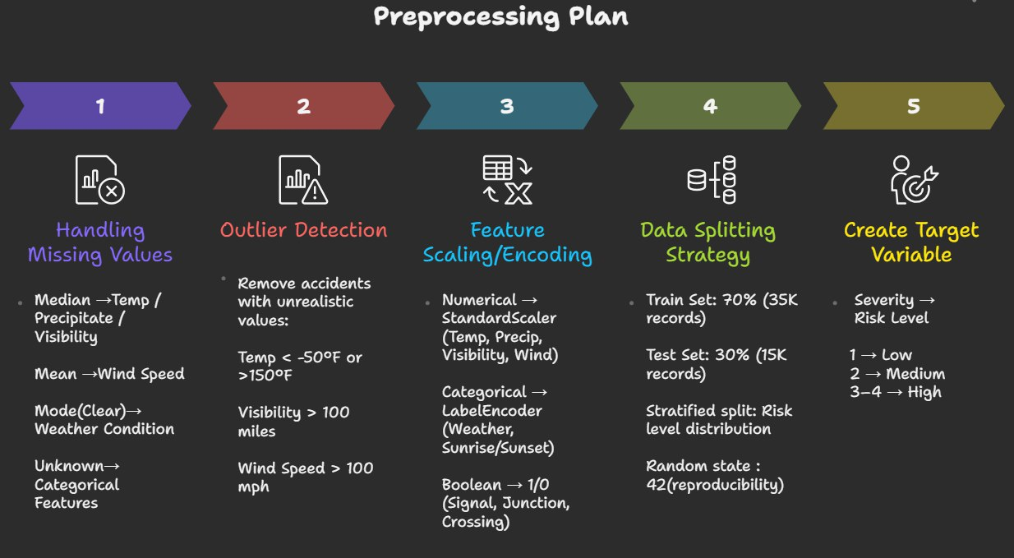

Slide 8
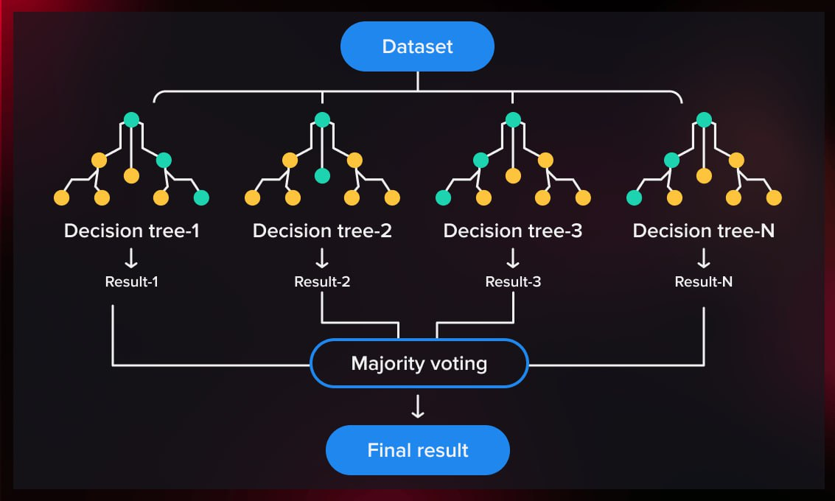
Model Selection
Random Forest Classifier

Slide 9
Model Selection Justification
High Accuracy Uses many decision trees together, so it gives more accurate and stable results than a single tree.
Shows Important Features Tells which factors (like weather or road condition) affect the prediction the most.
Works Well with Real Data Handles noisy data, outliers, and some missing values easily.
Moderate Complexity More powerful than simple models but easier to understand than deep learning models.
Fast and Efficient Trains quickly and works well for medium-sized datasets.

